Slide 1
TPAC1.0
Jamie Crooks

Slide 2
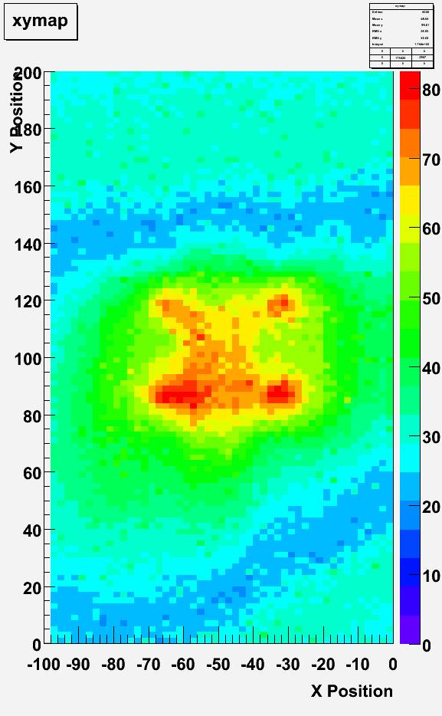
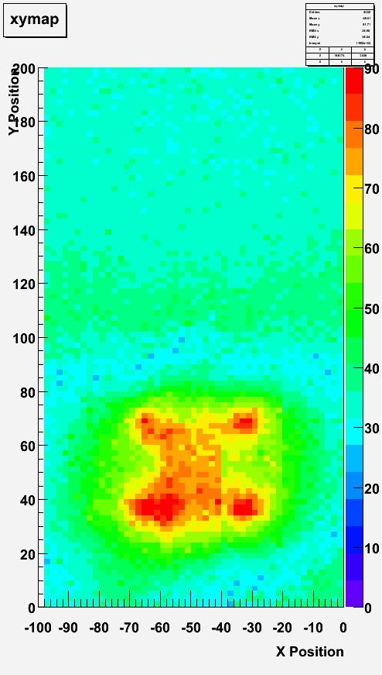
Laser Scans
2um spot
2um steps
Analog readout
Mean Signal
(25 samples)

Slide 3
Laser Scans
2um spot
2um steps
Analog readout
Mean Signal
(25 samples)

Slide 4
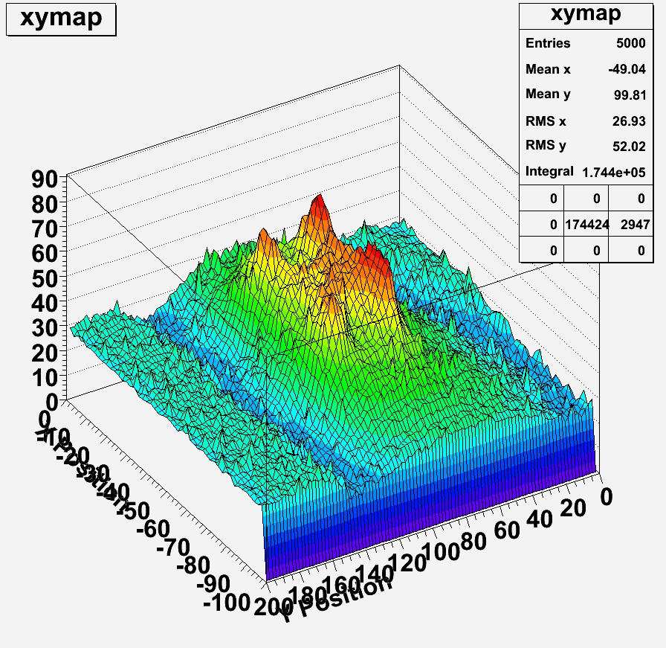

Slide 5
TPAC1.1 Status
Poor device yeild (short circuit)
  Typ 40% working, from 60 probed devices, but the 12u+DPW split is worst ~20%
Poor bonding yeild
  typ 40/250 fails per chip
Reported problems to foundry
  Will report back after some investigation
  Follow-up run (std + hi-res wafers) on hold until these investigations report back
Functionality
  Configuration load
    Errors – under investigation
  Data corruption (override mode)
    Fixed at RAL, but some low-level problems still reported at IC
    Will swap boards and investigate further
  Design feature
    Duplicated row-addresses → more details on later slides
  Test structures
    Monostables ok
    Laser scans → more details on later slides
    55Fe → more details on later slides/Marcel
  Threshold Scan → more details on later slides

Slide 6
TPAC1.1 Design error
Row addresses
  Should run 0→167
  Actually run 0→83,0→83
Ambiguity in location of a hit
Caused by copying chosen pixel sub-array to whole sensor
Matt & Paul’s suggested workaround
  Artificially store one hit per row
    Trivial to implement, one additional initialisation clock cycle before the bunch train begins
  All rows participate in (sequential) readout
    Hence we know where real hits sit in the datastream → array
  Reduced number of available memories to 18 per row
  Real-time processing (software?) to strip and correct data so data files stored are back-compatible format with false data removed.

Slide 7
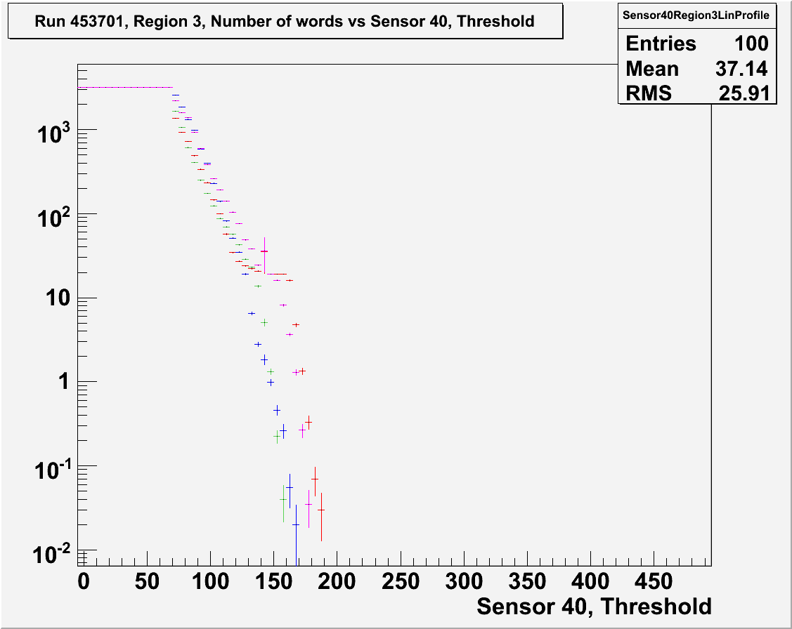
First look: TPAC1.1 Threshold scan

Slide 8
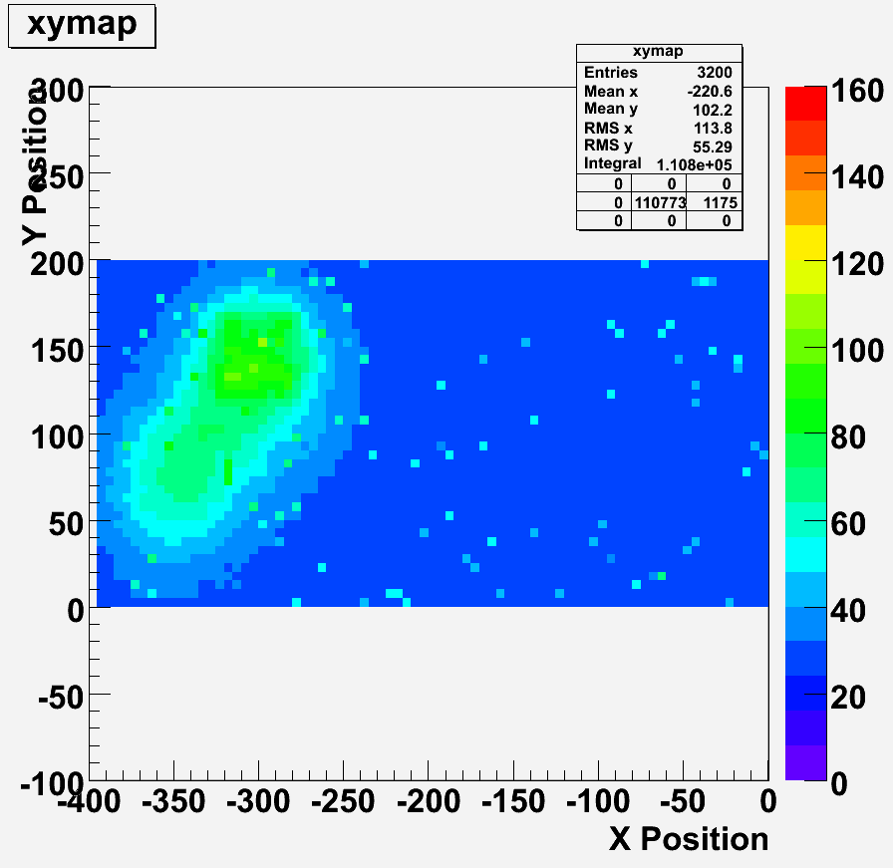
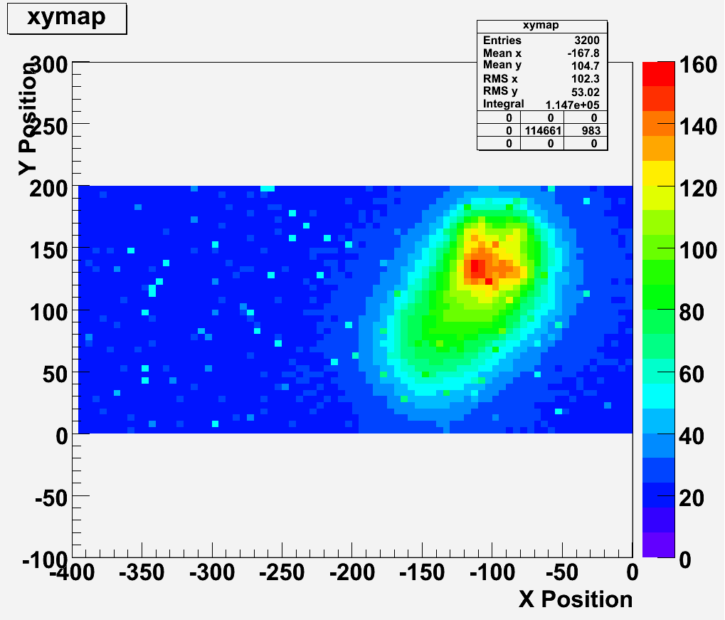
TPAC1.1
Laser Scans
First look!
Old preShape pixel
5um spot
5um steps
Analog readout
Mean Signal
(20 samples)
New preShape pixel

Slide 9
TPAC1.1
Laser Scans

Slide 10
TPAC1.1
Laser Scans

Slide 11
TPAC1.1
Laser Scans

Slide 12
Explanation?
PCB hole seen to be misaligned (camera on laser microscope used to check known positions of pixels)
Next: Try another sensor!

Slide 13
Summary
PCB | Sensor | Status
37 | 5u +DPW | At IC (→ RAL today) Problems with config load
40 | 5u +DPW | At RAL (JC) Ok (apart from config load) Currently being used for debug (soldered probes etc)
32 | 12u +DPW | At RAL Two dead columns Being used for analog test pixels (laser, 55Fe)
35 | 5u +DPW | At RAL Severe data corruption – to be investigated
36 | 5u +DPW | At RAL (→ IC today) ok (apart from config load)
31 | 12u +DPW | Bonding
32 | 12u +DPW | Bonding
38 | N/A | Power-ground short (from first round of bonding) Awaiting rework

