Slide 1
TPAC1.1 Testing
JC/Feb 27th 2009

Slide 2
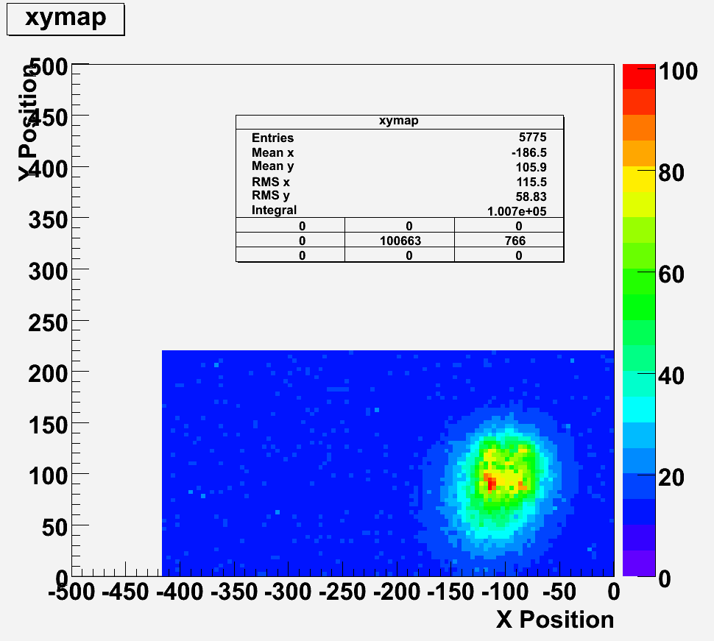
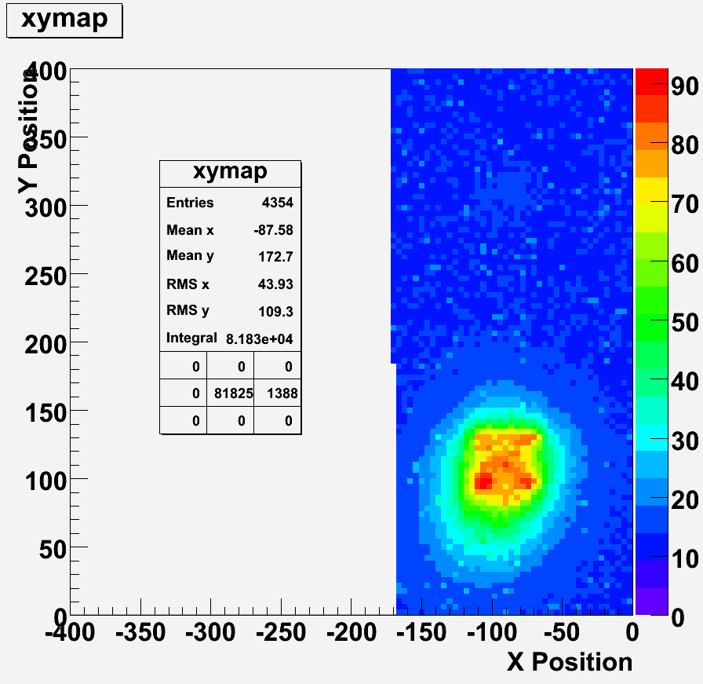
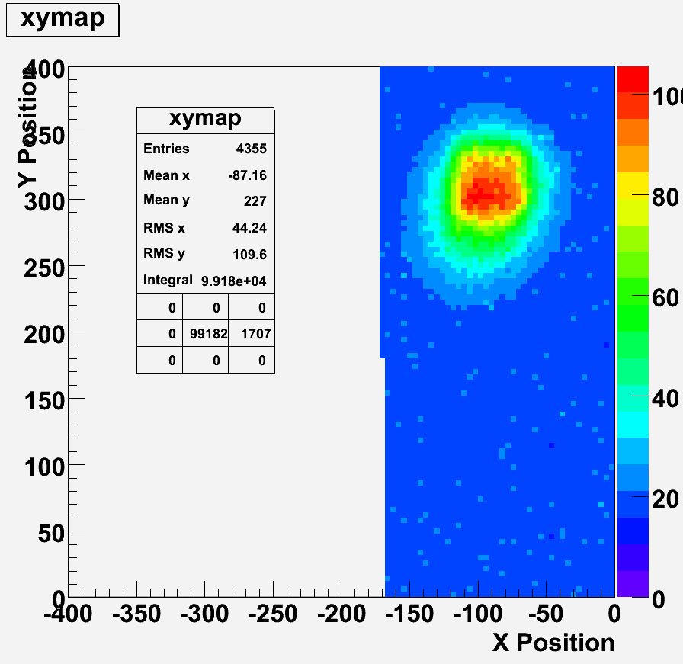
Pixel scans with rotation
Shorter run; lower statistics; hence more “noise” due to resets

Slide 3
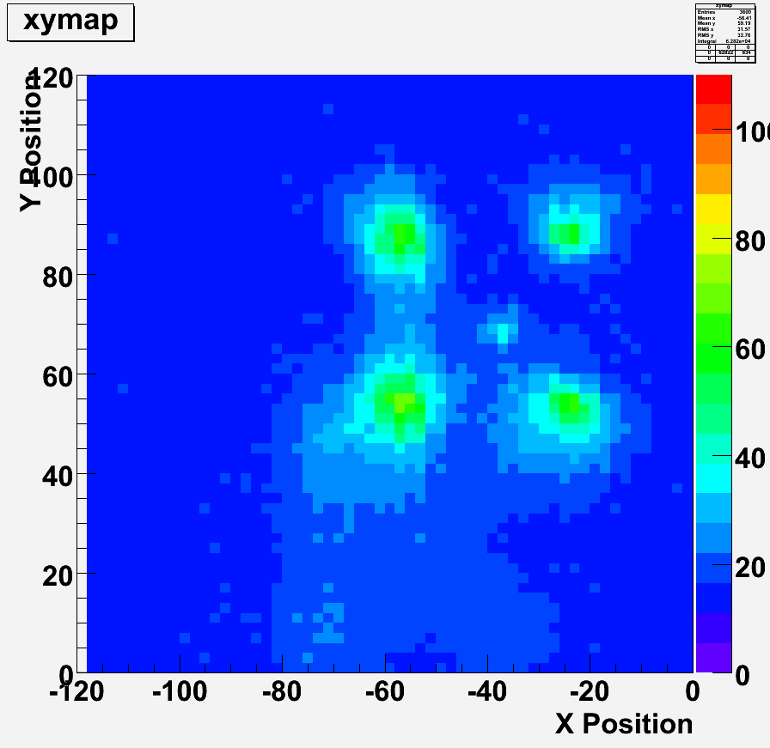
Detail scans (in progress)
12u no DPW: 2um resolution
12u with DPW: 4um resolution

Slide 6
Next steps
TU calibration vs trim
Laser/tilt studues
  Low spatial resolution for different sensor tilt angles
TU calibration for TPAC1.0
Full set of 2um resolution scans
  12/5/DPW/NoDPW

